Slide 1
Introduction to Data Science
Paul Anderson, Ph.D.
Department of Computer Science &
Software Engineering
California Polytechnic State University

Slide 2
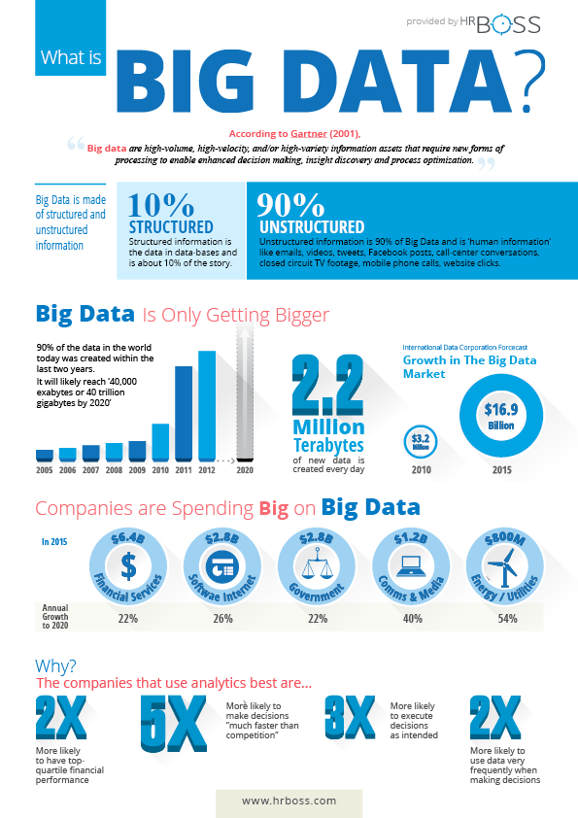
Overview
Big Data and Data Science
Real World Examples & Ethical Implications
Key technologies
https://hrboss.com/sites/default/files/imce/bigdata-infographic-p4.png

Slide 3
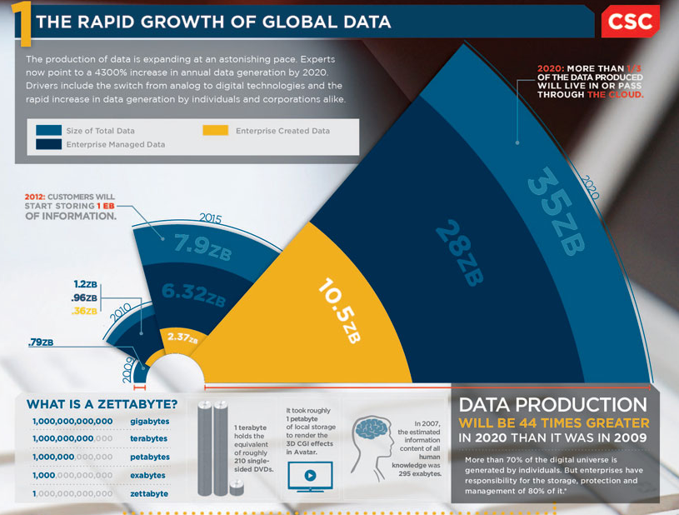
http://www.csc.com/insights/flxwd/78931-big_data_growth_just_beginning_to_explode

Slide 4
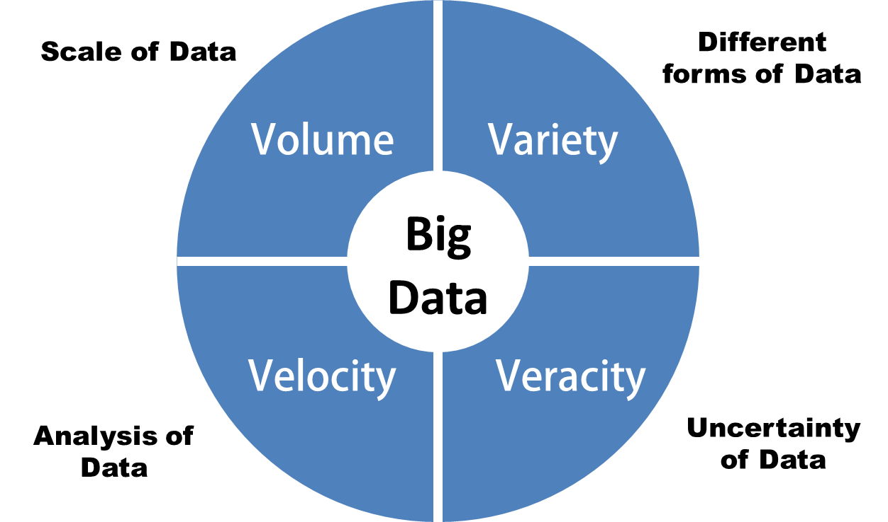
Domain Independent Big Data Characteristics
“From the dawn of civilization until 2003, humankind generated five exabytes of data. Now we produce five exabytes every two days… and the pace is accelerating”
– Eric Schmidt, Executive Chairman, Google
What makes data “Big”? Answer: The four V’s

Slide 5
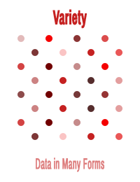
http://www.slideshare.net/apsheth/smart-data-how-you-and-i-will-exploit-big-data-for-personalized-digital-health-and-many-other-activities
http://www.havlena.net/en/business-analytics-intelligence/big-data-analytics-part-2-what-is-big-data/

Slide 6
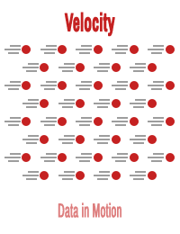
http://www.slideshare.net/apsheth/smart-data-how-you-and-i-will-exploit-big-data-for-personalized-digital-health-and-many-other-activities
http://www.havlena.net/en/business-analytics-intelligence/big-data-analytics-part-2-what-is-big-data/

Slide 7
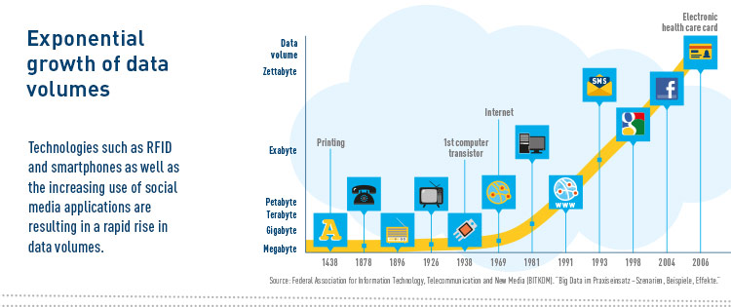
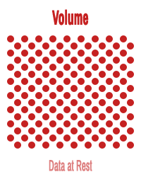
Volume
Refers to the vast amounts of data generated every second. We are not talking Terabytes but Zettabytes.
http://www.havlena.net/en/business-analytics-intelligence/big-data-analytics-part-2-what-is-big-data/
Notes:
If we take all the data generated in the world between the beginning of time and 2008, the same amount of data will soon be generated every minute. New big data tools use distributed systems so that we can store and analyze data across databases that are dotted around anywhere in the world.

Slide 8
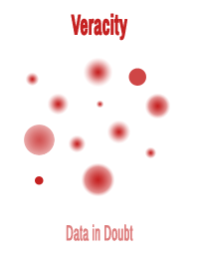
Veracity
Refers to the messiness or trustworthiness of the data.
Example: Twitter Posts
Hash tags
Abbreviations
Typos
colloquial speech
reliability and accuracy of content
http://www.havlena.net/en/business-analytics-intelligence/big-data-analytics-part-2-what-is-big-data/

Slide 9
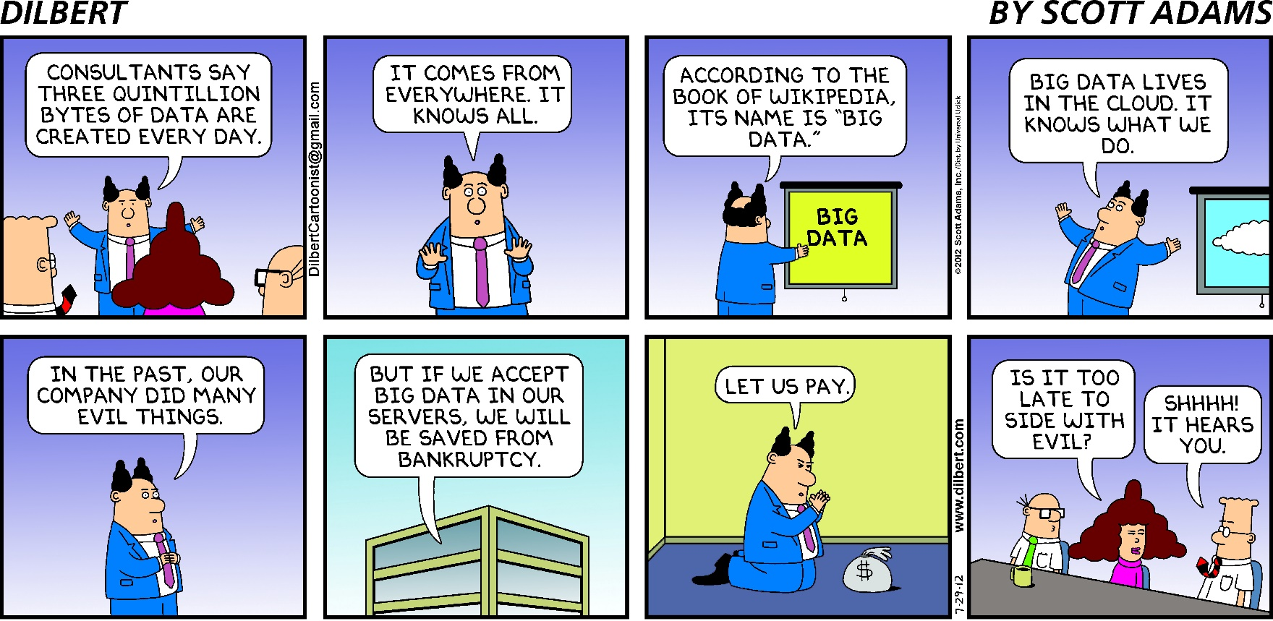
The fifth V: Value
We need new technology throughout the entire stack: cloud computing, distributed systems, software, analytics that allow us to leverage and gain value from the data.

Slide 10
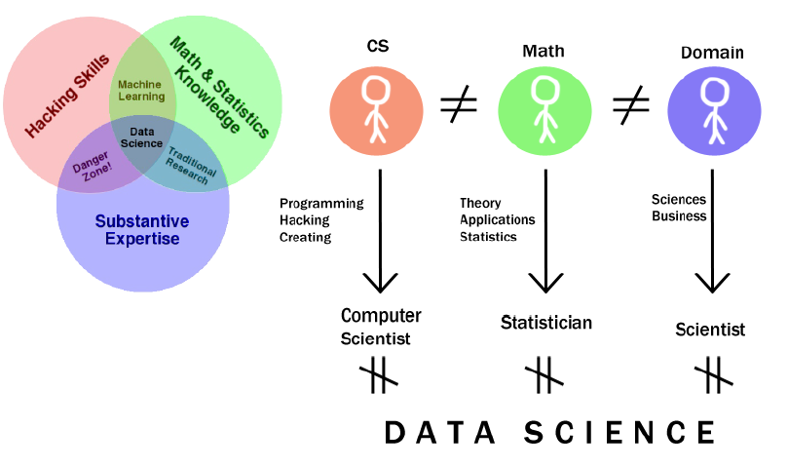
What is Data Science?

Slide 11
Overview
Introduction to Big Data and Data Science
Examples of Big Data and Ethical Concerns
Life Sciences
Earth Sciences
Social Sciences
Humanities
Internet of Things
Industry
Key technologies

Slide 12
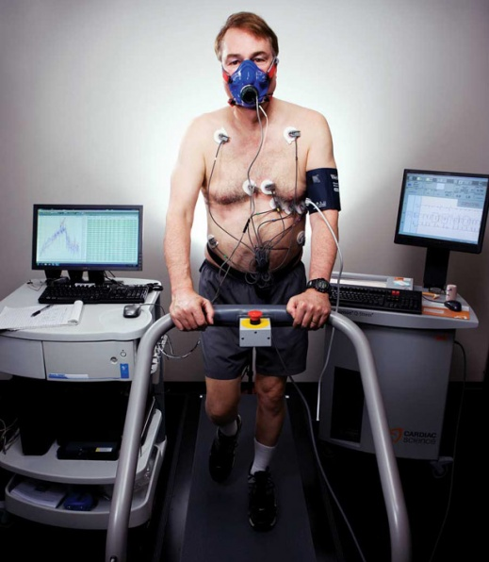
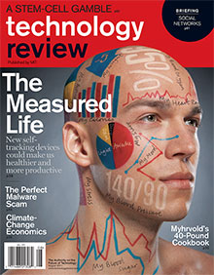
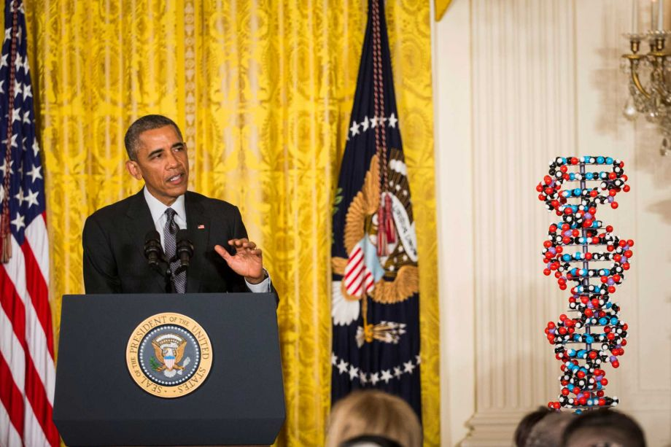
Patient of the Future
http://www.technologyreview.com/featuredstory/426968/the-patient-of-the-future/
http://ww1.hdnux.com/photos/34/35/67/7462364/5/920x1240.jpg
http://www.technologyreview.com/magazine/2011/07/
http://www.technologyreview.com/featuredstory/426968/the-patient-of-the-future/

Slide 13
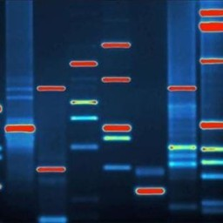
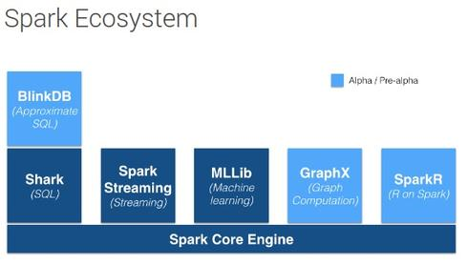
Case Study: Lighting fast genomics
Technology: Spark and ADAM What is genomics all about?
Medical Diagnosis
Drug Response
Disease mechanisms
Theory of Genomes
Conservation

Slide 14
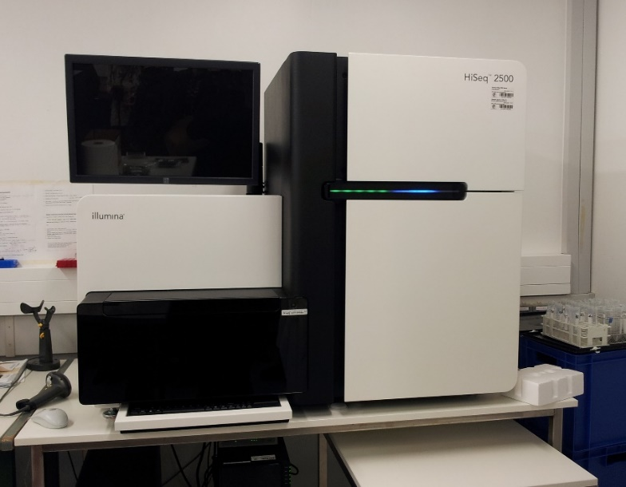
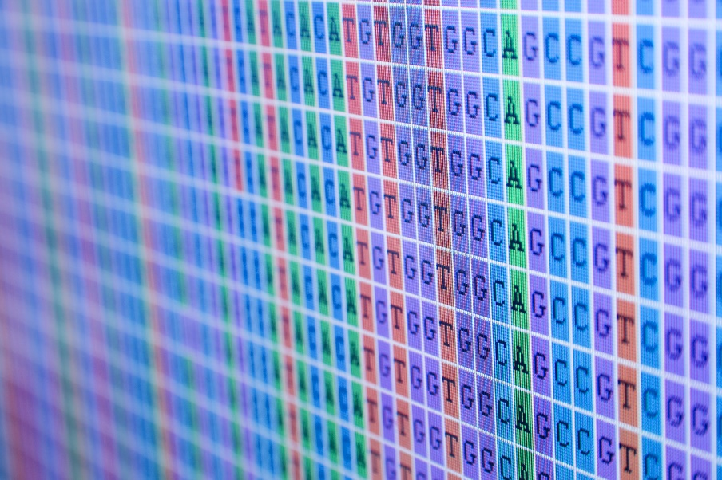
What is genomics all about?
A human genome is a 3 billion long sequence (of nucleic acids: “bases”)
1 per 1,000 base is variable in human population
Genomes encode bio-molecules (tens of thousands)
These molecules interact together … and with the environment

Slide 15
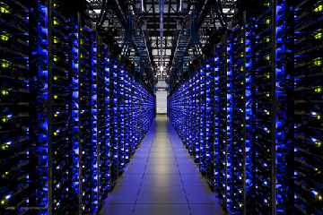
Problems?
I.T. becomes a bottleneck
Cost
Latency
Don’t want to sacrifice data with sampling or cut-offs to overcome I.T. bottlenecks
Source: http://photos1.meetupstatic.com/photos/event/b/a/f/6/event_218867862.jpeg

Slide 16
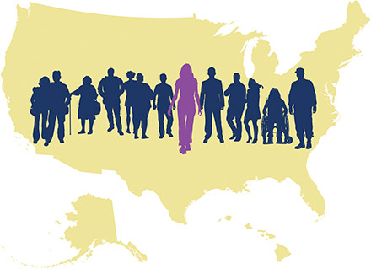
Problems with Legacy Approach
Legacy stack is not designed to be scalable (C, Perl, Java, …)
HPC approach not a fit
Traditionally engineered for compute-intensive tasks
We are now working on data-intensive and compute intensive tasks
Prepare for the future of genomics – Precision Medicine
Personal genomes (e.g., 1,000,000 genomes for cancer research)
New sequencing technologies
Sequence as needed (e.g., microbiome, diagnostics)
Leading to medical-condition = f(genomics, environment-history)

Slide 17
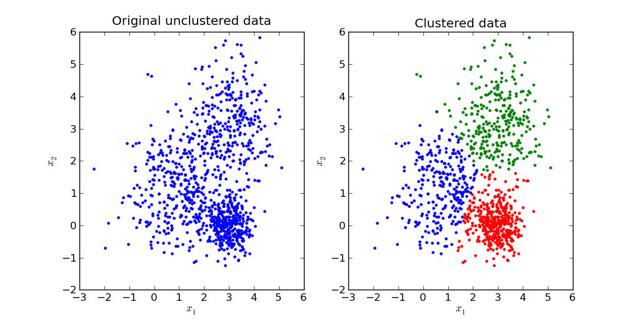
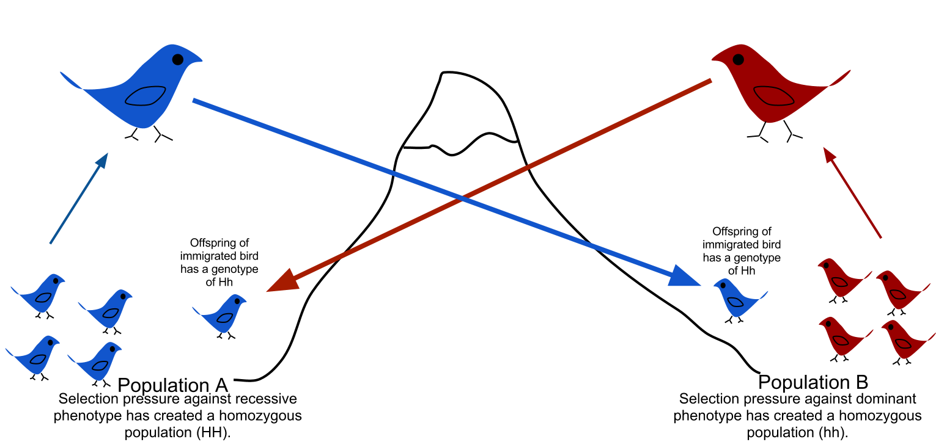
Question: Are populations clustering in the genomic data?
Run an unsupervised algorithm on a massive number of genomes
The idea is to find clusters (k-means) that would match subpopulations
This helps find patterns in population histories, gene flows, selection, etc

Slide 18
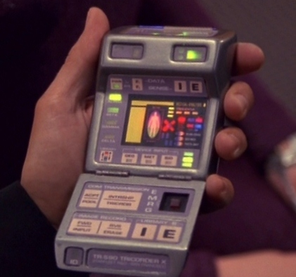
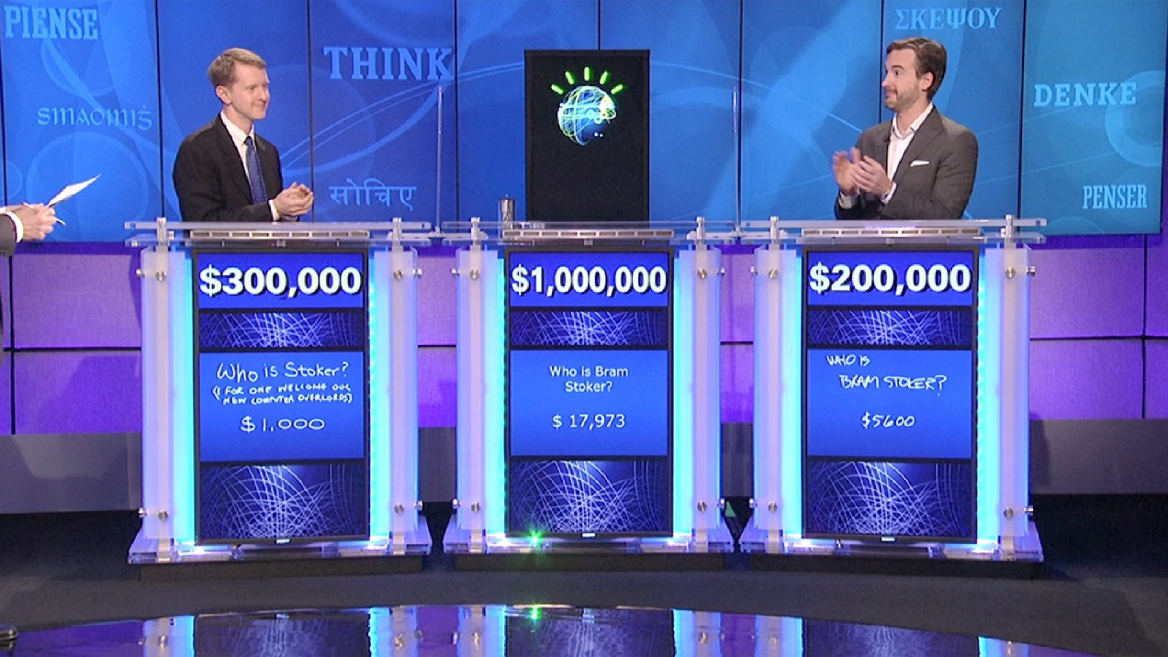
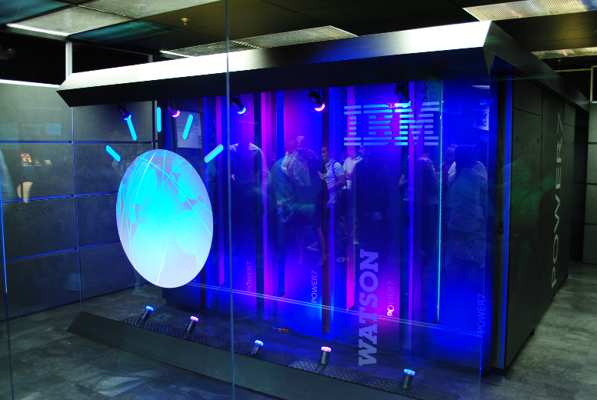
Turning computers into doctors

Slide 19
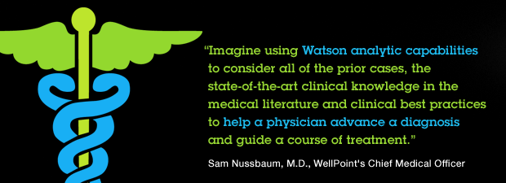
IBM Watson
It would require 160 hours of reading a week to keep up with new medical knowledge being published
In current tests, Watson’s diagnosis rate of lung cancer is 90%, compare to 50% on human doctors¹

Slide 20
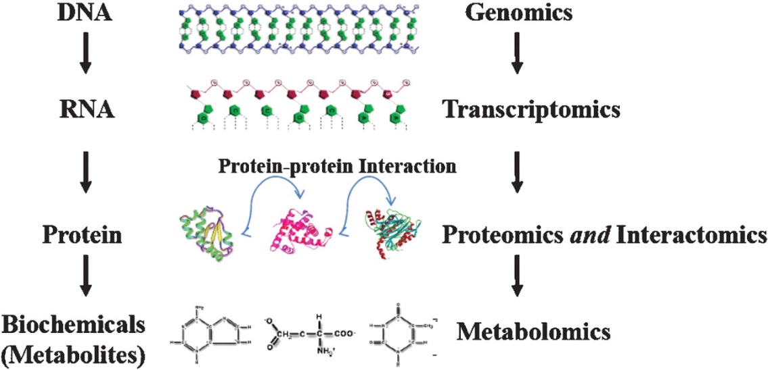
What about basic science?
Source: http://goo.gl/1yI5h5

Slide 21
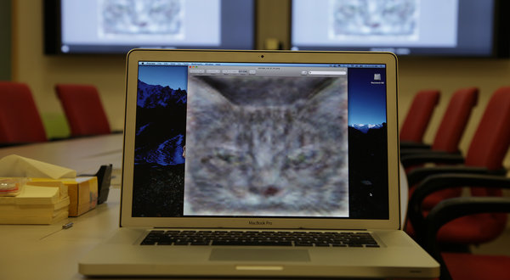
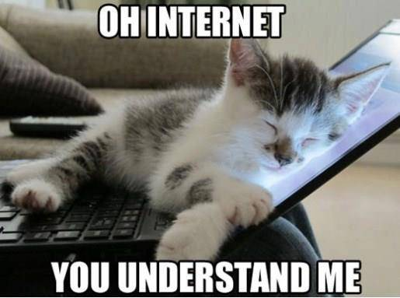
Health and medicine are important but what about cats?
Google scientists created one of the largest neural networks - 16,000 computer processor
What should we do with it? Answer: Turn it loose on the Internet to learn on its own.
Presented with 10 million digital images found in YouTube videos, what did Google’s brain do? Answer: What millions of humans do with YouTube: looked for cats.
The neural network taught itself to recognize cats, which is actually no frivolous activity. It performed far better than any previous effort by roughly doubling its accuracy in recognizing objects in a challenging list of 20,000 distinct items.
Notes:
http://www.nytimes.com/2012/06/26/technology/in-a-big-network-of-computers-evidence-of-machine-learning.html?_r=0

Slide 22
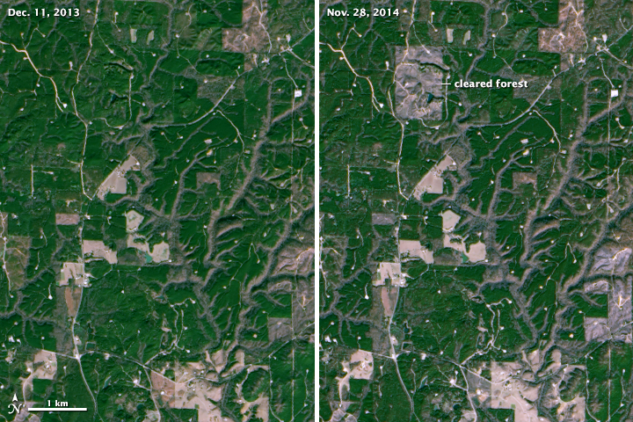
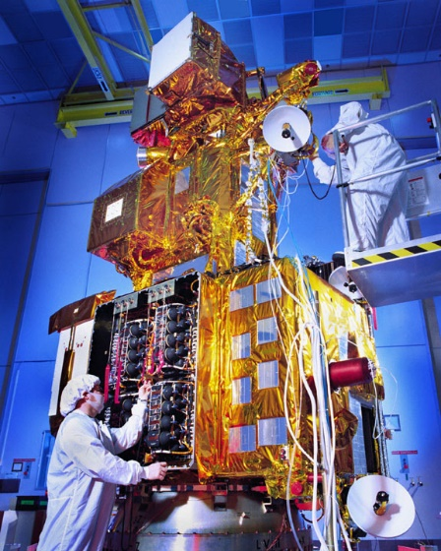
What else can we do with image analysis? Earth Sciences Big Data
Big Data Approach to Earth Imagery
2008, U.S. Geological Survey took 3.6 million images acquired by Landsat Satellites and made them free and openly available on the internet
Dating back to 1972, images are detailed enough to show the impact of human decisions on the land, and they provide the longest continuous view of Earth’s landscape from space
http://earthobservatory.nasa.gov/Features/LandsatBigData/
Notes:
http://earthobservatory.nasa.gov/Features/LandsatBigData/

Slide 23
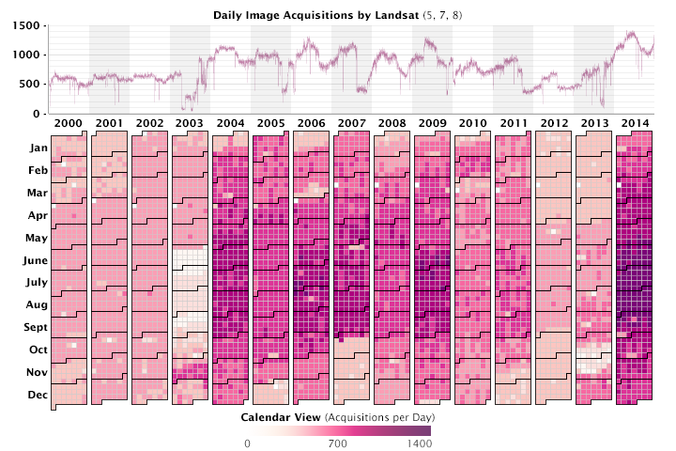
Landsat Data
Since 2000, more than 4.3 million images have been captured
Landsat 8 was launched in February 2013, significantly boosting the rate to as many as 1,400 images each day.
Graph by Joshua Stevens using data collected from the U.S. Geological Survey acquisitions archive
Notes:
http://landsat.usgs.gov/tools_acq.php

Slide 24
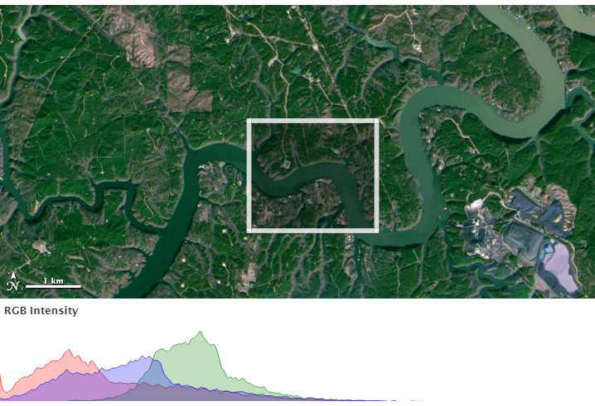
New possibilities and Results
Evan Brooks from Virginia Tech University gathered every Landsat measurement of the Westervelt forest taken between 2009 and 2011
A forest, field, or city block changes in predictable ways from year to year
Greening in the spring, browning in the winter
Measured values of light from a particular pixel take a curved shape that is pretty much the same from year to year.
“But where we see odd jumps or leaps,” Brooks noted, “we know that some change occurred.”

Slide 25
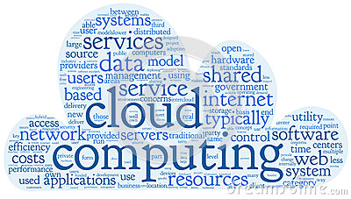
It Takes a Village of Computers
Brooks can run his forest analyses on a laptop, but he can only survey a small area. How do you scale up a pixel-based analysis to figure out how forests are changing around the world across four decades?
“The issue is scaling it up,” says Robert Kennedy, a remote sensing scientist at Boston University who has developed a similar analysis tool. “Even if you have a simple algorithm, you need a lot of computing to manage all of the data.”
How much data? “There are roughly 400 billion land pixels in a single global mosaic,” says Rama Nemani, a scientist who runs the NASA Earth Exchange (NEX), a supercomputing collaborative at NASA’s Ames Research Center. With at least one image of every location on Earth per season every year, the entire 43-year Landsat record contains more than 50 trillion pixels.

Slide 26
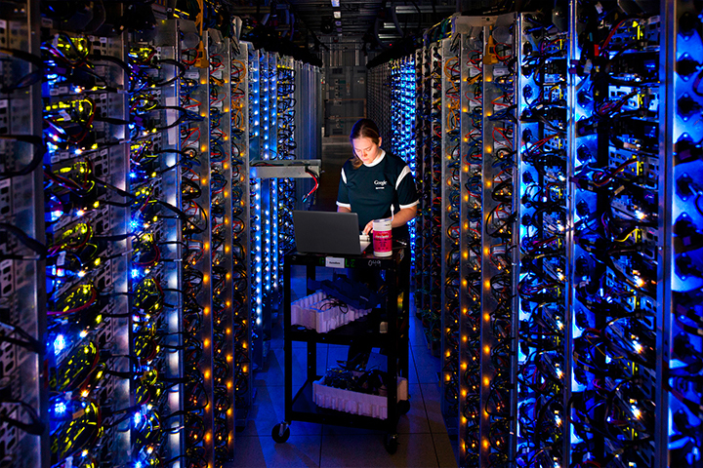
The processing and storage of data has changed significantly since 1972.
Four decades later, the storage is digital and mind-numbingly dense. Data silos at EROS hold thousands of tape cartridges storing up to 8 terabytes apiece. Google also maintains vast forests of servers and processors at its data centers.
(Photos courtesy of U.S. Geological Survey and Connie Zhou/Google.)

Slide 27
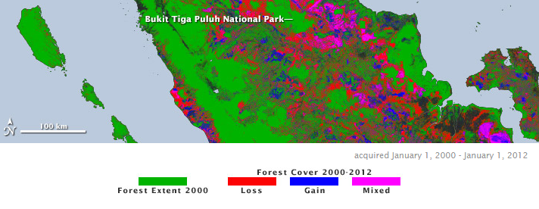
For years, Goward and Hansen worked with low-resolution data that did not have a lot of detail
Study impact of disturbance—harvesting, thinning, fires, storms
No one knows the patterns of forest disturbance or how they impact the carbon cycle
Until 2008, Landsat data were too expensive to consider a global map.
“We did the science we could afford, not the science we wanted to do,” Goward said.
Hansen ported their code for mapping forests to the Google Computer Cluster
Moore noted: “The analysis would have taken 15 years on a single computer.” We can now do it in a couple of days.
“It is the first global assessment of forest change in which you can see the human impact,” said Masek.

Slide 28
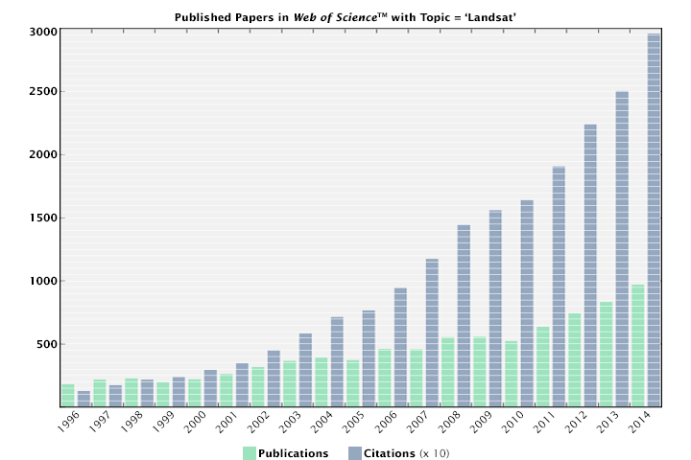
Big Data Means Bigger Questions
“In the past, I used to bring data to my computer and analyze it,” Masek noted. But the questions have gotten bigger than that type of analysis can sustain. “Now it’s impossible to bring all the data to my computer.” Instead, scientists develop analysis tools and bring them to computation workhorses like Google Earth Engine or NEX. “We can implement our algorithms where the data live. It’s a different way of mining the Landsat archive.”
We used to bring the data to the algorithm
Now we bring the algorithm to the data
Notes:
References
Brooks, E. B., et al. (2013) On-the-fly massively multitemporal change detection using statistical quality control charts and Landsat data. IEEE Transactions on Geoscience and Remote Sensing.
Hansen, M.C., et al. (2013, November 15) High-resolution global maps of 21st-century forest cover change. Science.
Moore, R. (2014, June 26) Maps for good: Saving trees and saving lives with petapixel–scale computing. Google I/O 2014.
Roy, D.P., et al. (2014, February 1) Landsat-8: Science and product vision for terrestrial global change research. Remote Sensing of Environment.

Slide 29
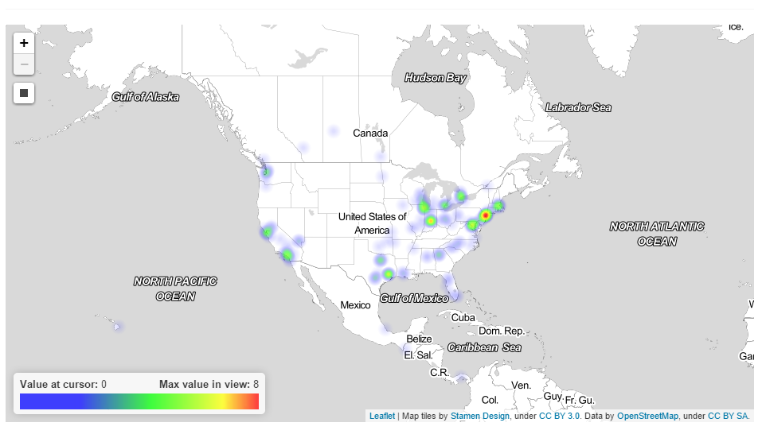
What about other sources of data?
Heatmap of Ebola Tweets

Slide 30
Twitter and Geolocation
Twitter provides a massive amount of spatiotemporal information
What does twitter data contain?
Opinions, moods, activities, geolocation … veracity
Twitter has been mined for a variety of purposes
Analyze natural hazard events to understand if tweets contribute to increasing situational awareness of nearby residents
Map social, political, and geographic attributes of tweeters sharing online news articles to explore the relationship between individual identities and collective group dynamics
Notes:
http://www.public.asu.edu/~wenwenl1/papers/17.pdf
©

Slide 31
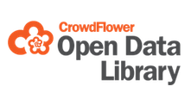
Online Data Science Competitions
Often, researchers develop their own pipeline.
What if we want to experiment with this type of work?
What if we want to get this type of data into the classroom?
The training set contains tweets, locations, and a confidence score for each of 24 possible labels. The 24 labels come from three categories: sentiment, when, and kind. Human raters can choose only one label from the "sentiment" and "when" categories, but are allowed multiple choices for the "kind". Your goal is to predict a confidence score of all 24 labels for each tweet in the test set.

Slide 32
Big Data in Political Science
Validation: What Big Data Reveal about Survey Misreporting and the Real Electorate Stephen Ansolabehere and Eitan Hersh Political Analysis (2012) 20(4): 437-459
Evaluating Online Labor Markets for Experimental Research: Amazon.com's Mechanical Turk Adam J. Berinsky, Gregory A. Huber, and Gabriel S. Lenz Political Analysis (2012) 20(3): 351-368
Inferential Network Analysis with Exponential Graph Models Skyler J. Cranmer and Bruce A. Desmarais Political Analysis (2011) 19(1): 66-86
Finding Jumps in Otherwise Smooth Curves: Identifying Critical Events in Political Processes Marc T. Ratkovic and Kevin H. Eng Political Analysis (2010) 18(1): 55-77The Genealogy of Law Tom S. Clark and Benjamin E. Lauderdale Political Analysis (2012) 20(3): 329-350
Notes:
http://www.oxfordjournals.org/our_journals/polana/virtualissue4.html

Slide 33
Berinsky, Huber and Lenz show how Amazon.com’s Mechanical Turk can be used for the recruitment of subjects for field experimentation
Field experiments are an important methodology that many social scientists use to test many different behavioral theories
Berinsky, Huber, and Lenz show how large-scale field experiments can be accomplished at low cost. This illustrates how new big data approaches are being applied to develop new means of collecting data for political science research problems
Notes:
Evaluating Online Labor Markets for Experimental Research: Amazon.com's Mechanical Turk
We examine the trade-offs associated with using Amazon.com’s Mechanical Turk (MTurk) interface for subject recruitment. We first describe MTurk and its promise as a vehicle for performing low-cost and easy-to-field experiments. We then assess the internal and external validity of experiments performed using MTurk, employing a framework that can be used to evaluate other subject pools. We first investigate the characteristics of samples drawn from the MTurk population. We show that respondents recruited in this manner are often more representative of the U.S. population than in-person convenience samples—the modal sample in published experimental political science—but less representative than subjects in Internet-based panels or national probability samples. Finally, we replicate important published experimental work using MTurk samples.

Slide 34
Twitter and Psychology
The Twitter Big 5 experiment investigates what someone’s Twitter activity could say about their personality especially, to those who might be looking but without asking.
Data about a participants Twitter activity
e.g. the number and frequency of Tweets, number of followers, Klout score and a linguistic anaysis of historic Tweets.

Slide 35
Data-Driven Campaigns Zero in on Voters
Modern political campaigns home in on their key voters with drone-like precision, down to the smallest niche — like Prius-driving single women in Northern Virginia who care about energy issues. They compile hundreds of pieces of data on individuals, from party registration to pet ownership to favorite TV shows. And they can reach people through Facebook, Pandora, Twitter, YouTube or cable television.
The only problem: They do not have enough messages for them all.
The Big Data era of politics has left some campaigns drowning in their own sophisticated advances. They simply cannot produce enough new, effective messages to keep up with the surgical targeting that the data and analytics now allow.
“Our ability to target has far outstripped our ability to create,” said Alex Lundry, co-founder of Deep Root Analytics, a Republican media analytics firm. “We do have too many options and not enough time, and I do think it’s a problem.”
Notes:
http://www.nytimes.com/2014/10/31/us/politics/data-driven-campaigns-zero-in-on-voters-but-messages-are-lacking.html?_r=0
http://harvardmagazine.com/2014/03/why-big-data-is-a-big-deal

Slide 36
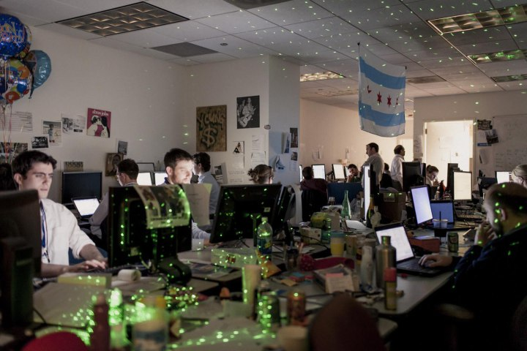
Inside the Secret World of the Data Crunchers Who Helped Obama Win
A massive data effort helped Obama raise $1 billion
Remade the process of targeting TV ads and created detailed models of swing-state voters that could be used to increase the effectiveness of everything from phone calls and door knocks to direct mailings and social media.
http://swampland.time.com/2012/11/07/inside-the-secret-world-of-quants-and-data-crunchers-who-helped-obama-win/
Notes:
For all the praise Obama’s team won in 2008 for its high-tech wizardry, its success masked a huge weakness: too many databases. Back then, volunteers making phone calls through the Obama website were working off lists that differed from the lists used by callers in the campaign office. Get-out-the-vote lists were never reconciled with fundraising lists. It was like the FBI and the CIA before 9/11: the two camps never shared data. “We analyzed very early that the problem in Democratic politics was you had databases all over the place,” said one of the officials. “None of them talked to each other.” So over the first 18 months, the campaign started over, creating a single massive system that could merge the information collected from pollsters, fundraisers, field workers and consumer databases as well as social-media and mobile contacts with the main Democratic voter files in the swing states.

Slide 37
Diverse Data Streams and Sources
We will discuss case studies in big data and examples across a variety of disciplines
Life Sciences (e.g., genomics, biomedical)
Earth Sciences (e.g., spatial and geolocated data)
Social Sciences
Humanities
Internet of Things
Notes:
Session will provide an overview of key concepts for big data and an overview of the diverse data streams and sources available across disciplines, including big data in the life sciences (e.g., genomics, biomedical), earth sciences (e.g., spatial and geolocated data), social science, and the humanities.

Slide 38
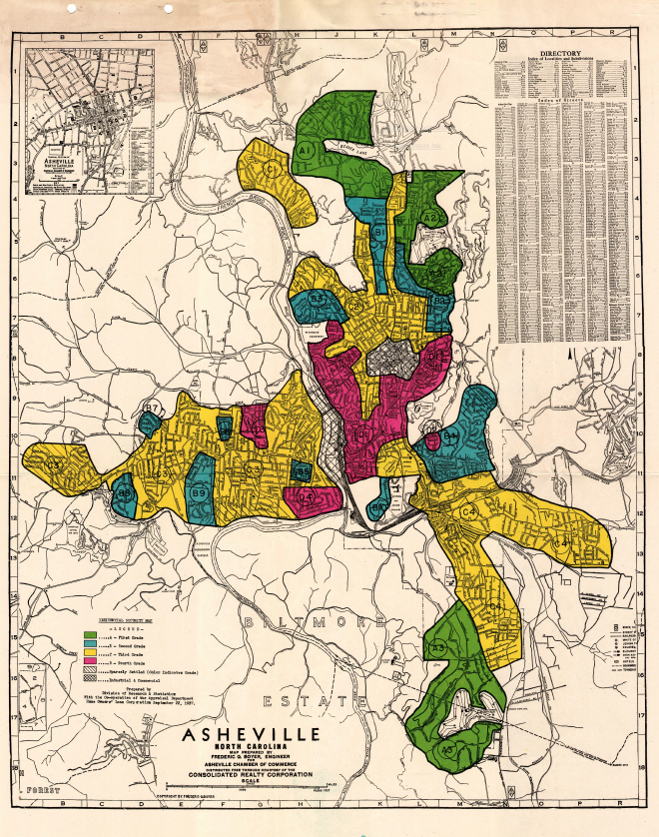
Big Data in the Humanities - Mapping Inequality: Redlining in New Deal America
In the 1930s, the Home Owners’ Loan Corporation (HOLC) federal agency was established in the US in response to the mortgage crisis of the Great Depression.
HOLC created neighborhood-by-neighborhood maps and accompanying area descriptions describing threats to the “security” of a particular area.
The maps categorized specific areas in cities according to four color-coded categories based on racial, ethnic, and economic characteristics of residents and potential home buyers: green for the best areas, followed by blue, yellow (for areas in risk of decline), and red areas for the least desirable areas.
Notes:
http://bighumanities.net/
In addition to granting loans and introducing standard lending practices, the HOLC also made assessments of major cities and urban areas around the country to determine safe and risky investment areas.

Slide 39
Big Data in the Humanities - Mapping Inequality: Redlining in New Deal America
Neighborhoods were graded based on the presence or absence of ethic and racial groups, relief and low-income families, and environmental problems, to name a few.
A partnership has been formed to build a national redlining collection.
Digitize the entire HOLC collection of maps and area descriptions
Georeferencing and vectorizing maps at scale, improving optical character recognition (OCR), and devising approaches to harvesting the content from the area description forms.
Notes:
http://bighumanities.net/
In addition to granting loans and introducing standard lending practices, the HOLC also made assessments of major cities and urban areas around the country to determine safe and risky investment areas.

Slide 40
Redlining Richmond
Working with local lenders and realtors, HOLC assessed neighborhoods using a number of factors ranging from terrain to income levels to the "infiltration of a lower grade population" (by which they meant African Americans, Jews, and immigrants).
Using these assessments they assigned a grade for each neighborhood's "residential security.“
Green "A" neighborhoods were the "hot spots" where mortgages were deemed to be reasonably safe.
Red "D" areas were "characterized by detrimental influences in a pronounced degree," and mortgages in these areas were considered much more risky. The HOLC produced maps for each city showing the grades for all areas.
Notes:
http://diggingintodata.org/awards/news/digging-data-featured-ieee-big-data-2014-conference
http://dsl.richmond.edu/holc/pages/home

Slide 41
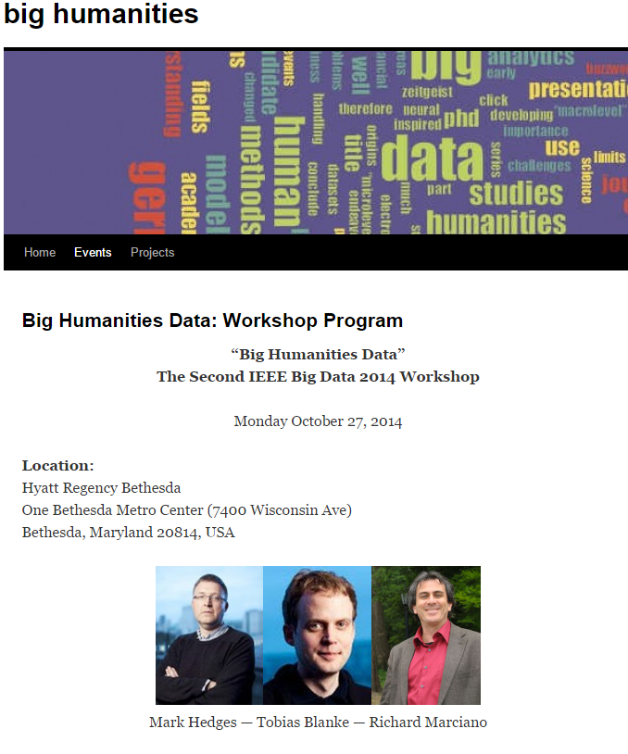
The future is exciting!
From the IEEE Big Data Conference
THEMES: complexity / scale / historical analysis
THEMES: news / film
THEMES: geospatial / mobile

Slide 42
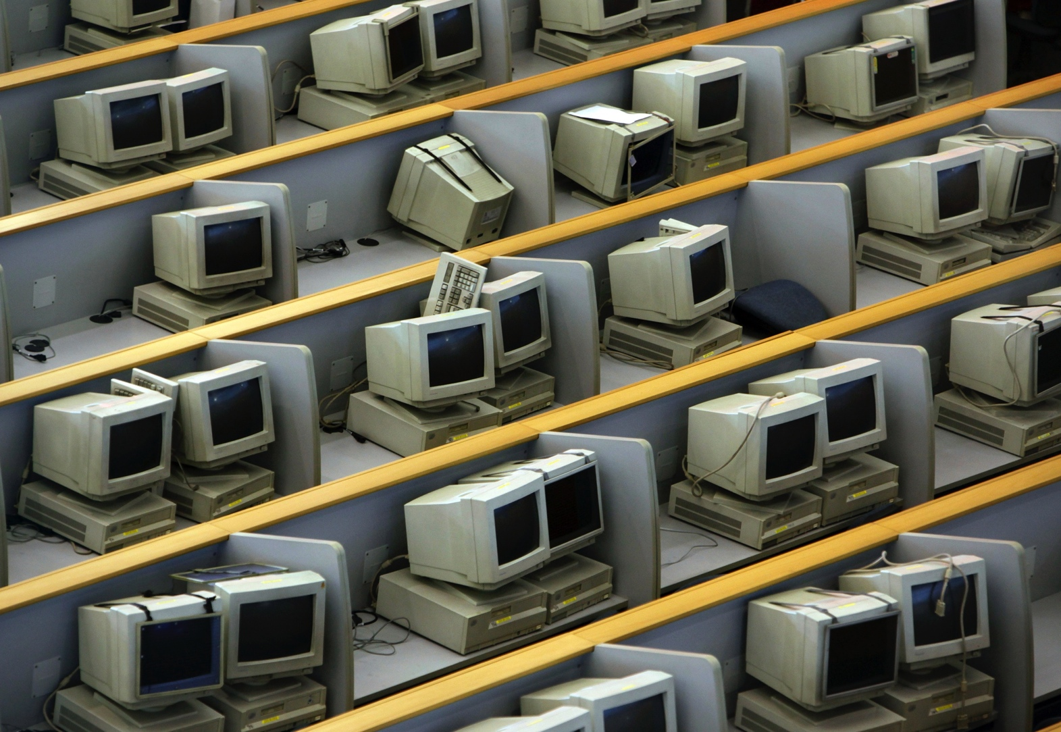
The Old Internet Ran On Personal Computers
Image: Reuters

Slide 43
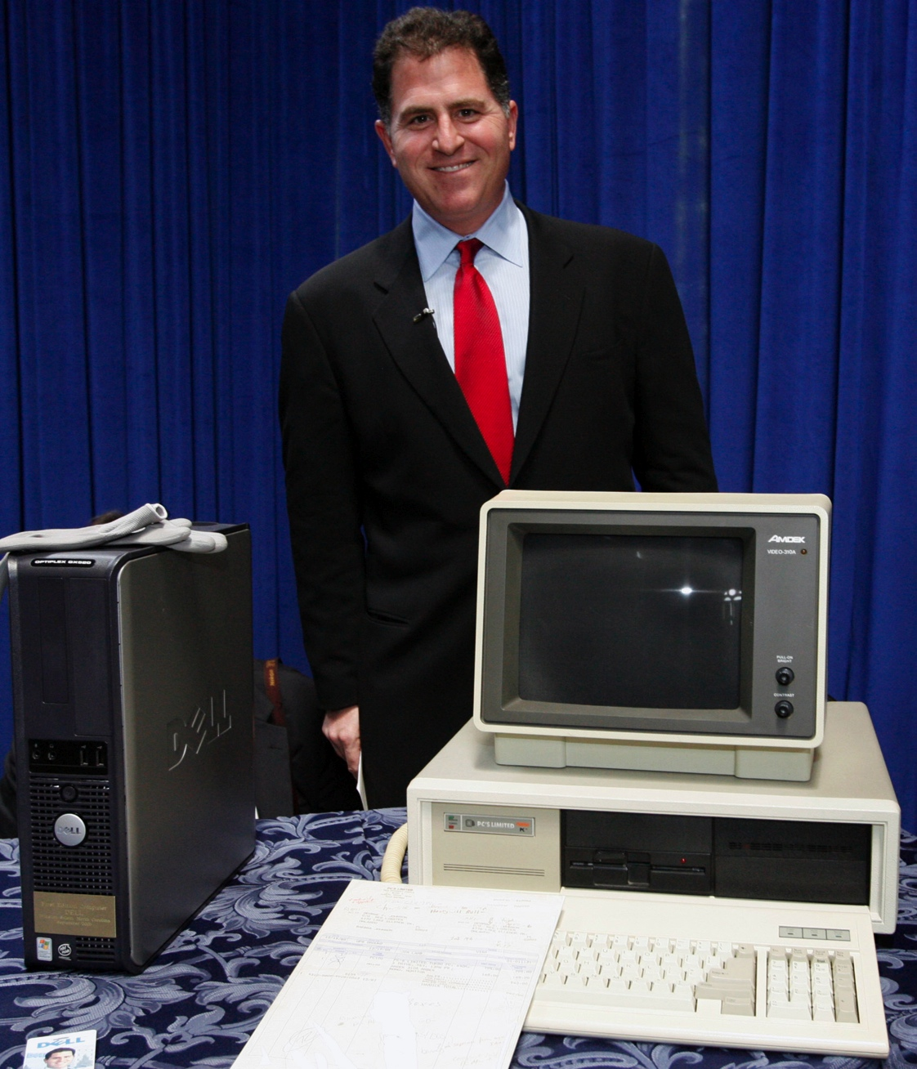
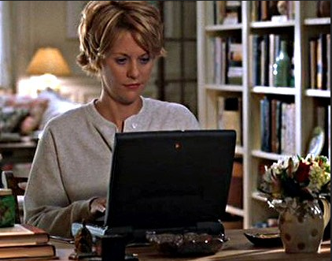
For Consumers
And Businesses

Slide 44
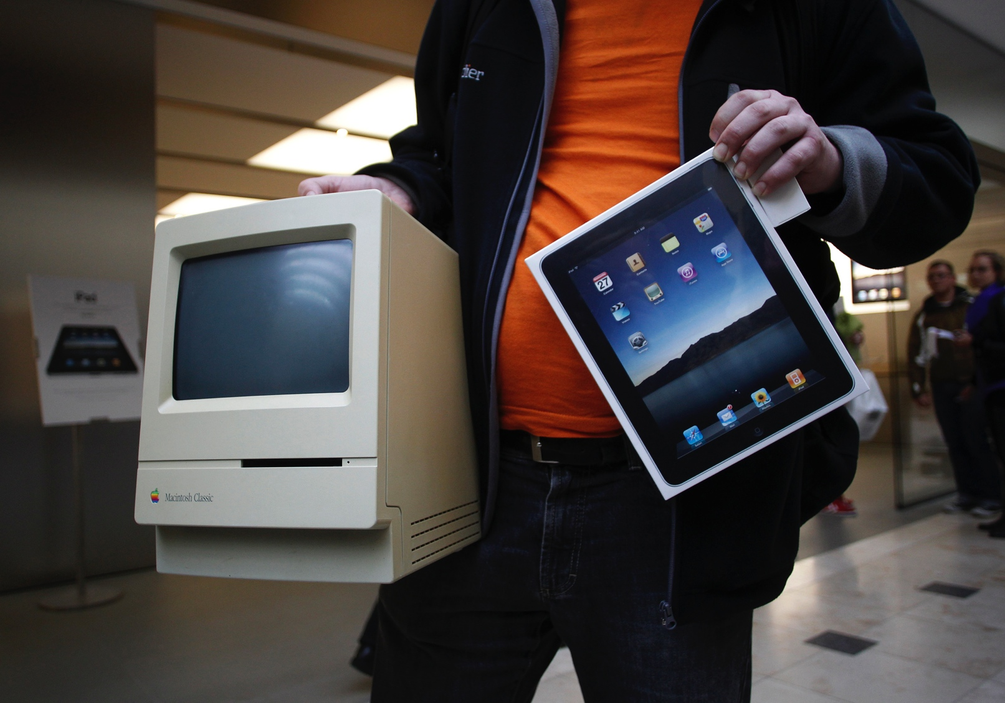
But Habits And Technology Have Changed
Image: Reuters

Slide 45
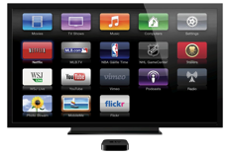
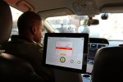
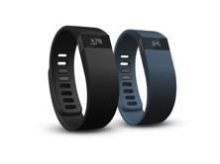
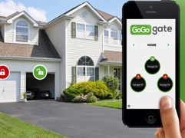
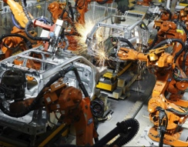
“Connecting products to the Web will be the 21st century electrification.”
Where We Are…Devices
PCs
Tablets
Smartphones
Connected TVs
Connected Cars
Wearables
— Matt Webb, CEO of BERG Cloud
Where We’re Going…’Things’
Smart homes
Smart cities
Smart offices
Smart factories

Slide 46
Big Data from the Internet of Things
http://www.qubole.com/wp-content/uploads/2014/10/The-Internet-of-Things-and-Big-Data_big.png
http://tarrysingh.com/wp-content/uploads/2014/07/473976504_1280-1024x576.jpg

Slide 47
We are living in a data rich time Red: Pictures Taken by Tourists Blue: Pictures Taken by Locals
https://www.flickr.com/photos/walkingsf/4671589629/

Slide 48
The Rise of the Data Artists
Two different kinds of artists
Those who work with large bodies of scientific data and
Those who are influenced by self-tracking.
http://www.theatlantic.com/entertainment/archive/2015/05/the-rise-of-the-data-artist/392399/

Slide 49
http://www.rcrwireless.com/20150319/big-data-analytics/what-you-dont-know-about-big-data-tag20

Slide 50
Server Capacity
http://www.rcrwireless.com/20150319/big-data-analytics/what-you-dont-know-about-big-data-tag20

Slide 51
Big Data in Industry
New Stanford research finds computers are better judges of personality than friends and family¹
“…computers have a couple of key advantages over human beings in the area of personality analysis. Above all, they can retain and access large quantities of information, and analyze all this data through algorithms.” – Michael Kosinski
Facebook Data Center
http://www.wired.com/2014/03/facebook-decade-big-data/
http://www.bigdata-madesimple.com/wp-content/uploads/2013/12/companies.png
¹http://news.stanford.edu/news/2015/january/personality-computer-knows-011215.html

Slide 52
Ethics of Big Data
http://img.pandawhale.com/post-26288-superheroes-google-facebook-am-BsNj.jpeg

Slide 53
Key Technologies

Slide 55
https://doubleclix.wordpress.com/2013/02/17/big-data-tech-platforms-products/

Slide 56
Roles and stakeholders: Please forgive the images…
IT, informatics, computer science, domain, … This is already happening…
Computational genomics team:

Slide 57
Building Big Data and Data Science focused curriculum can help support other disciplines

Slide 58
Time Spent as Data Scientist

Slide 59
Sources, Links, and Resources
http://www.1000genomes.org/
http://bdgenomics.org/
http://bdgenomics.org/projects/adam/
https://cloud.google.com/genomics/#get-started
http://www.nih.gov/precisionmedicine/
https://spark.apache.org/
https://hadoop.apache.org/

Slide 60
DATA 301?
You’ll get heavy ML and AI elsewhere (DATA 401, etc)
We need to get you sharp when it comes to cleaning, organizing, obtaining data, and deploying your models
We will of course build models, but we will treat them as mostly black box algorithms

